Slide 1

Visualization for Decisions
matplotlib + seaborn
cookbook
DS-2002
Jason Williamson
Fall 2026
Notes:
Lecture framing
This lesson assumes basic Python dictionaries, lists, loops, and functions. Plan approximately 65–75 minutes including the syntax discussion and applied exercise. Slides 2–7 establish the problem and context. Slides 8–19 develop structure and validation. Slides 20–27 support a Python walkthrough. Slides 28–29 close the core lesson. Slides 31–35 provide optional reference material and solutions.
Instructor preparation
Python 3 is sufficient for the standard-library examples. The later demonstrations use pandas, requests, and jsonschema. Use a notebook or Python interpreter alongside the deck. Copy the complete fictional dataset from slide 12 into campus_air.json in the working directory. Every displayed code example is also repeated as plain text in the relevant notes. The dataset does not describe measured UVA air quality.

Slide 2
A chart is an argument
A topic title reports what you plotted.
A message title states what the reader should conclude.
If the reader stopped at the title, would they know what to do differently?
02

Slide 3
Four rules we enforce
01
One chart, one message
Two sentences means two charts.
02
The title states the finding
Not the axes. Not the variable names.
03
Label axes and name the unit
Revenue (USD), not revenue.
04
Sort by value
Unless time or another natural order applies.
03

Slide 4
Picking the chart from the question
The question | The chart
How do categories compare? | Horizontal bar, sorted
How did this change over time? | Line, time on the x-axis
Do two numbers move together? | Scatter with a trend line
How is one number distributed? | Histogram or box plot
Parts of a whole over time? | Stacked area or grouped bar
Pie charts compare angles badly. More than three slices, use a bar chart.
04

Slide 5
Three tools, one stack
matplotlib
seaborn
The engine. Figure, axes, annotations, savefig. Use the object style: ax.set_title, not plt.title.
DataFrame in, chart out. barplot, lineplot, regplot, heatmap, relplot. Finish with matplotlib.
fig, ax = plt.subplots(figsize=(7, 3.5))
sns.barplot(data=df, y='category', x='revenue', ax=ax)
finish(ax, 'Merch brings in the most revenue', xlabel='revenue (USD)')
Seaborn wants long data: one row per observation, columns for x, y, and hue.
05

Slide 6
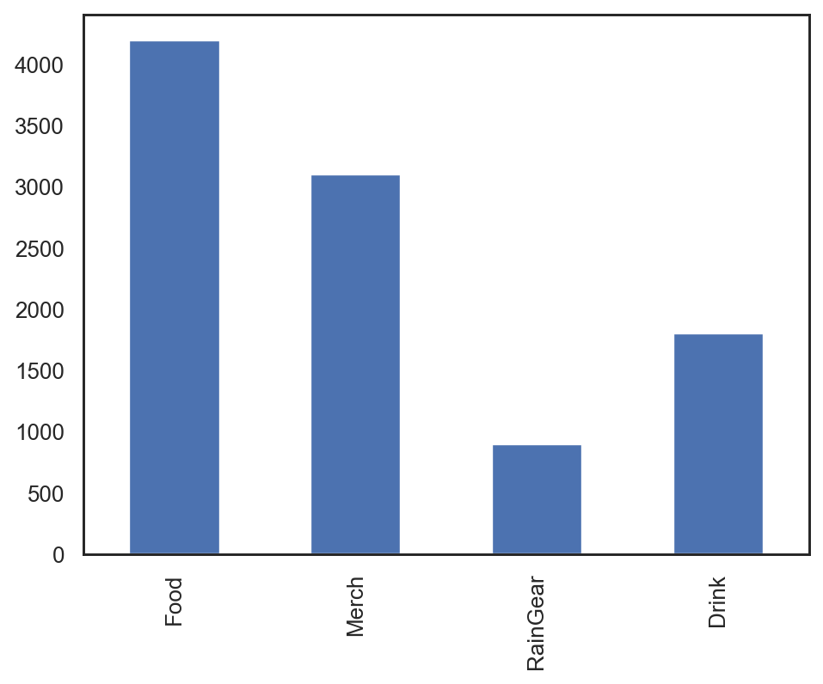
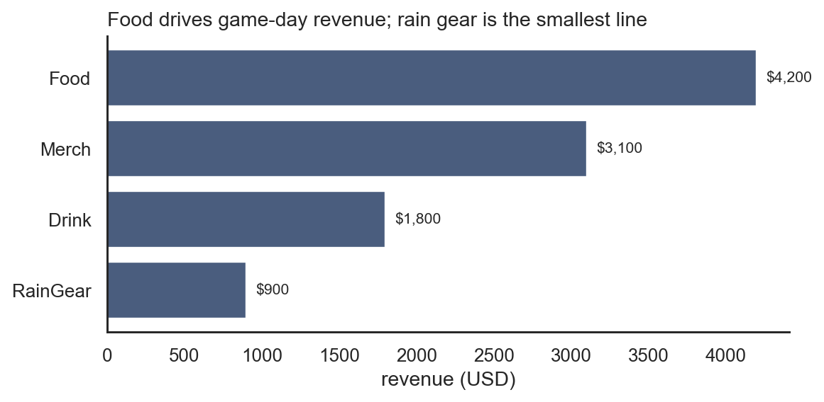
Default chart, then the fix
Sorted horizontal bar, finding in the title, unit on the axis, values on the bars.
06

Slide 7
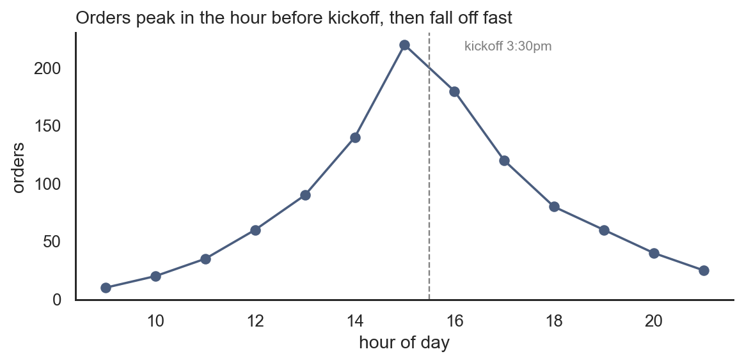
Time series and the annotation
Mark the moment that explains the shape. Staff up before kickoff, not after.
07

Slide 8
Four mistakes that cost points
01
Truncated y-axis on bars
Bar length is the comparison. Start at zero.
02
Overplotting
Lower alpha and marker size so density shows.
03
Raw counts across different groups
Divide by traffic, visitors, or exposure.
04
No tight_layout
Clipped labels look careless in a deck.
08

Slide 9
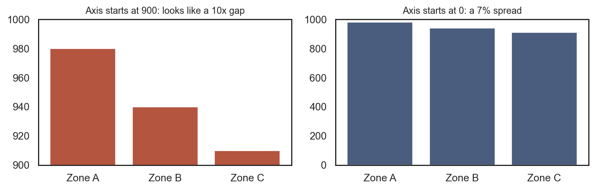
Truncated axis exaggerates
09

Slide 10
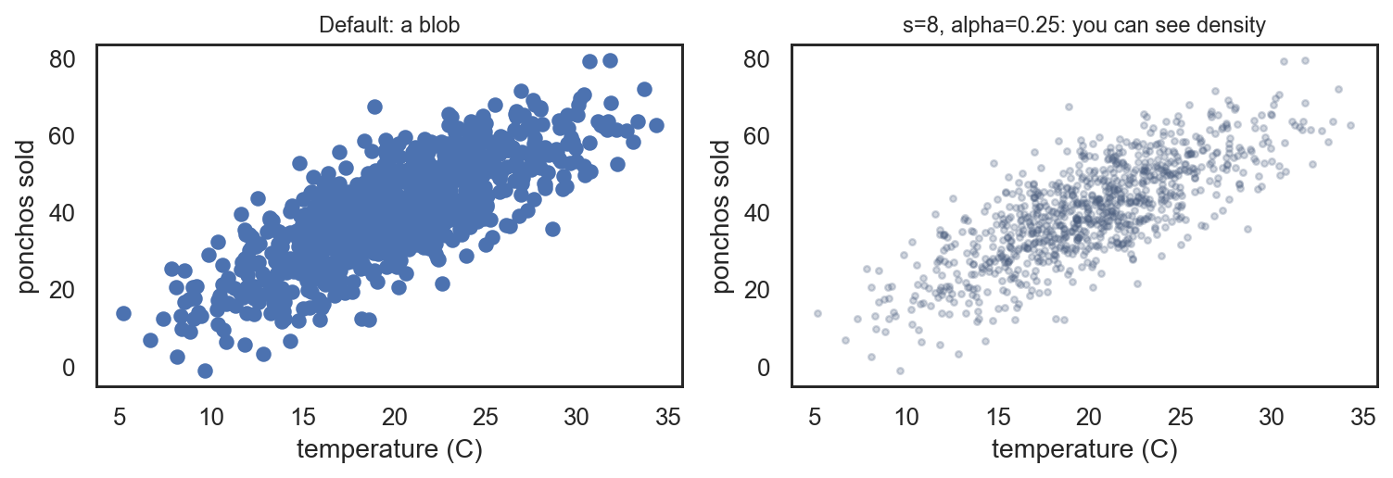
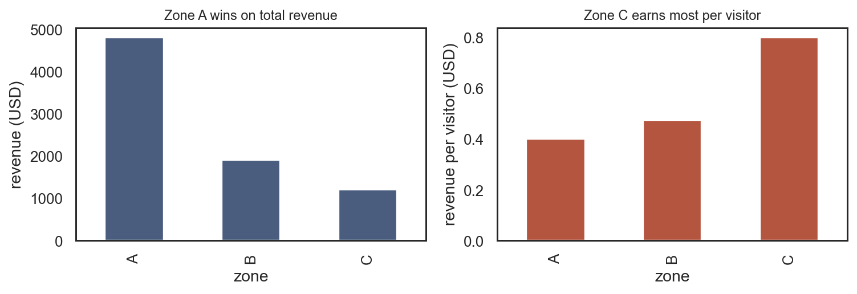
Overplotting and normalization
Zone A wins on total revenue. Zone C wins on revenue per visitor. Pick the chart for the decision.
10

Slide 11
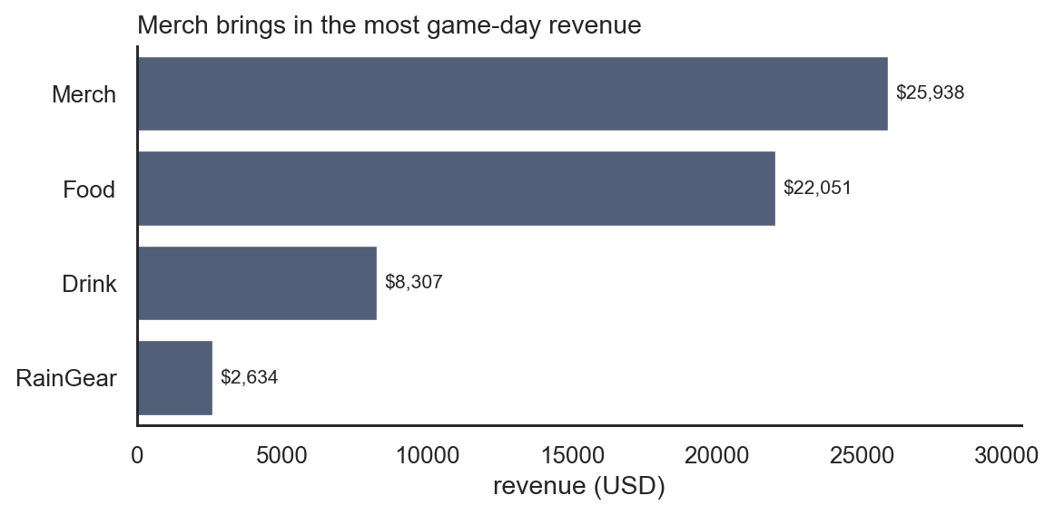
Recipe compare categories
s = df.groupby('category')['revenue'].sum().sort_values()
bars = ax.barh(s.index, s.values)
ax.bar_label(bars, labels=[f'${v:,.0f}' for v in s.values])
11

Slide 12
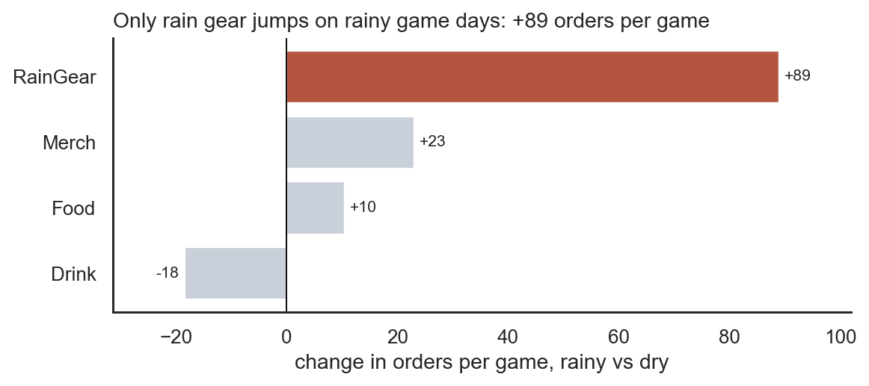
Recipe highlight one bar
Gray for context, rust for the one category that answers the question.
12

Slide 13
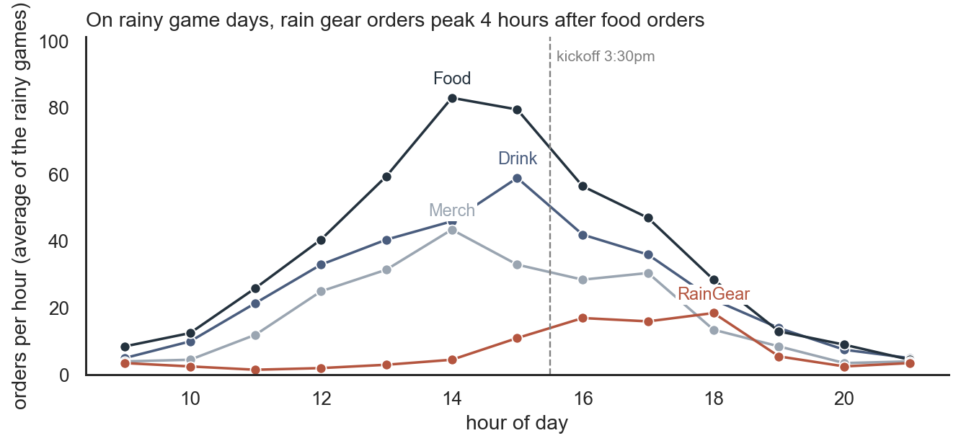
Recipe lines labeled directly
Direct labels beat a legend when you have four lines or fewer.
13

Slide 14
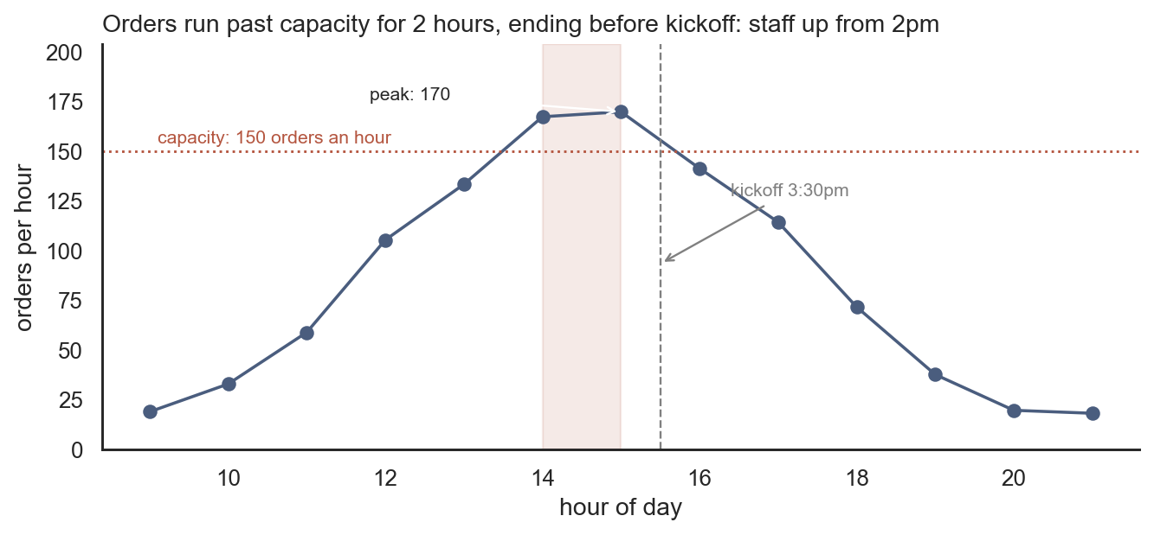
Recipe annotations
axvline, axhline, axvspan, annotate. Each annotation should answer one question.
14

Slide 15
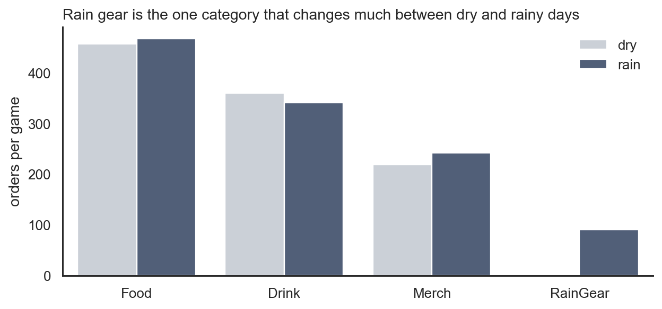
Recipe grouped bars
15

Slide 16
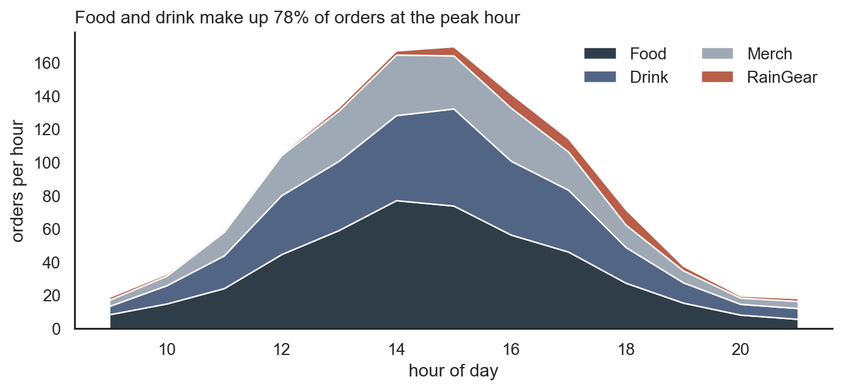
Recipe stacked area
16

Slide 17
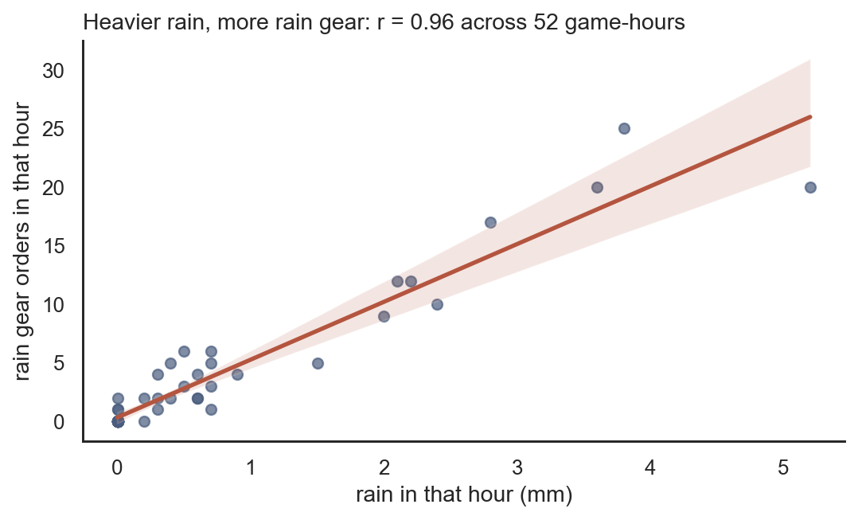
Recipe scatter and trend
Put r and n in the title. Strong r is not causation.
17

Slide 18
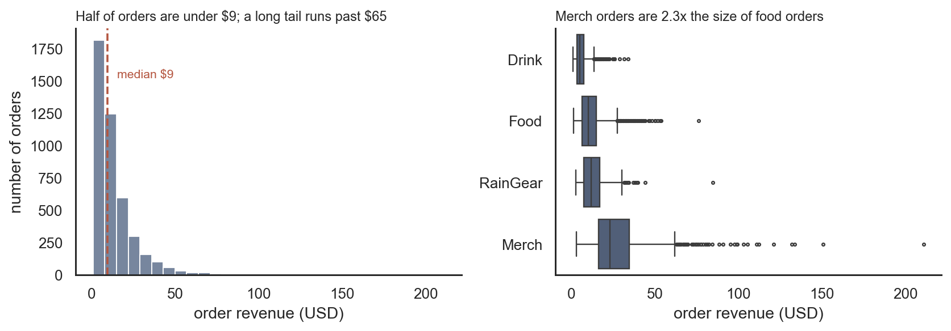
Recipe distribution
18

Slide 19
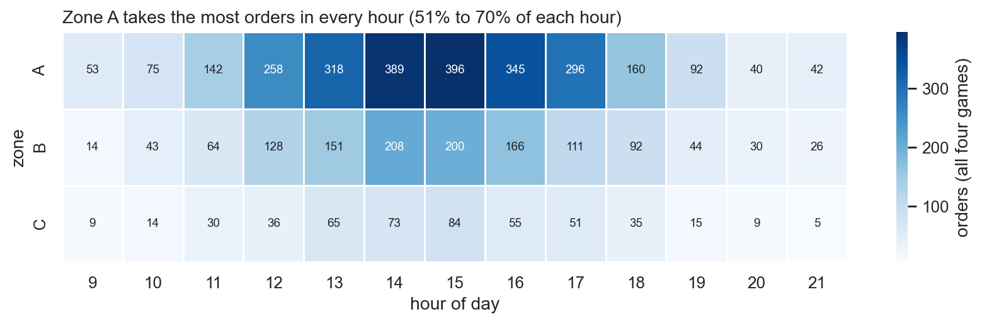
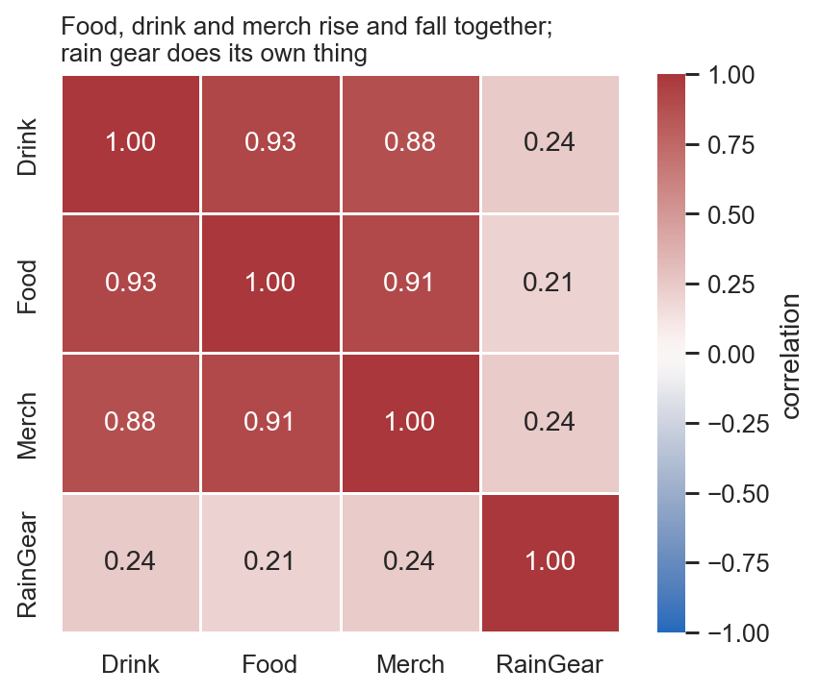
Recipe heatmaps
19

Slide 20
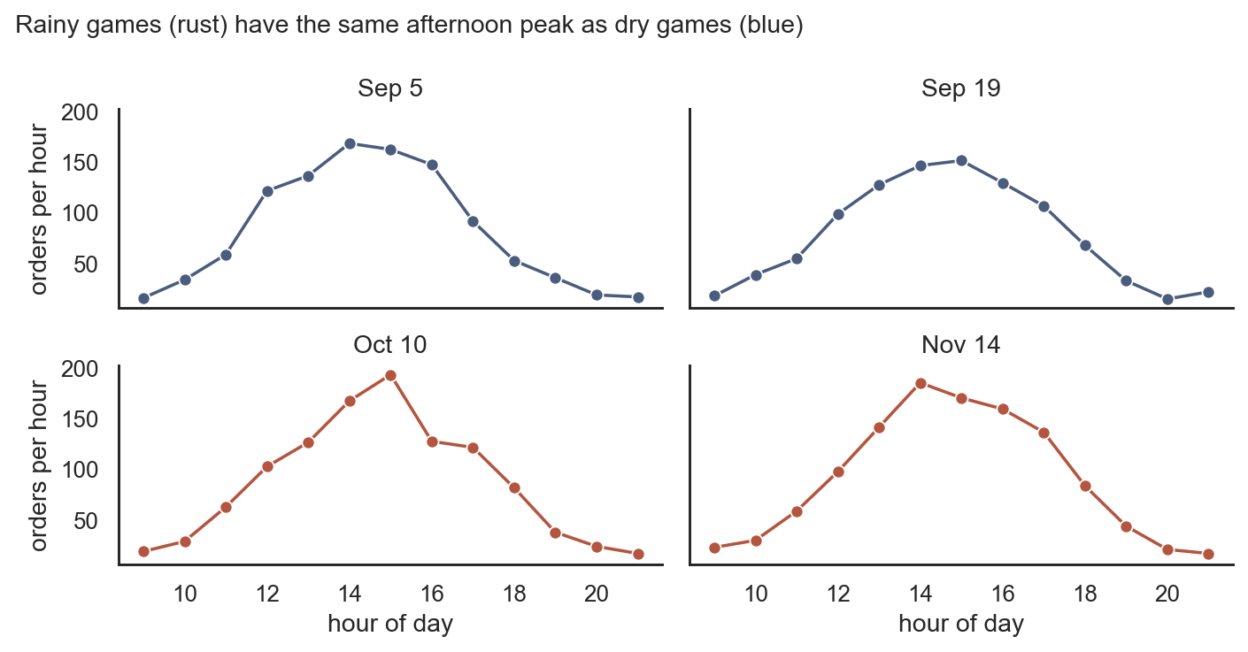
Recipe small multiples
20

Slide 21
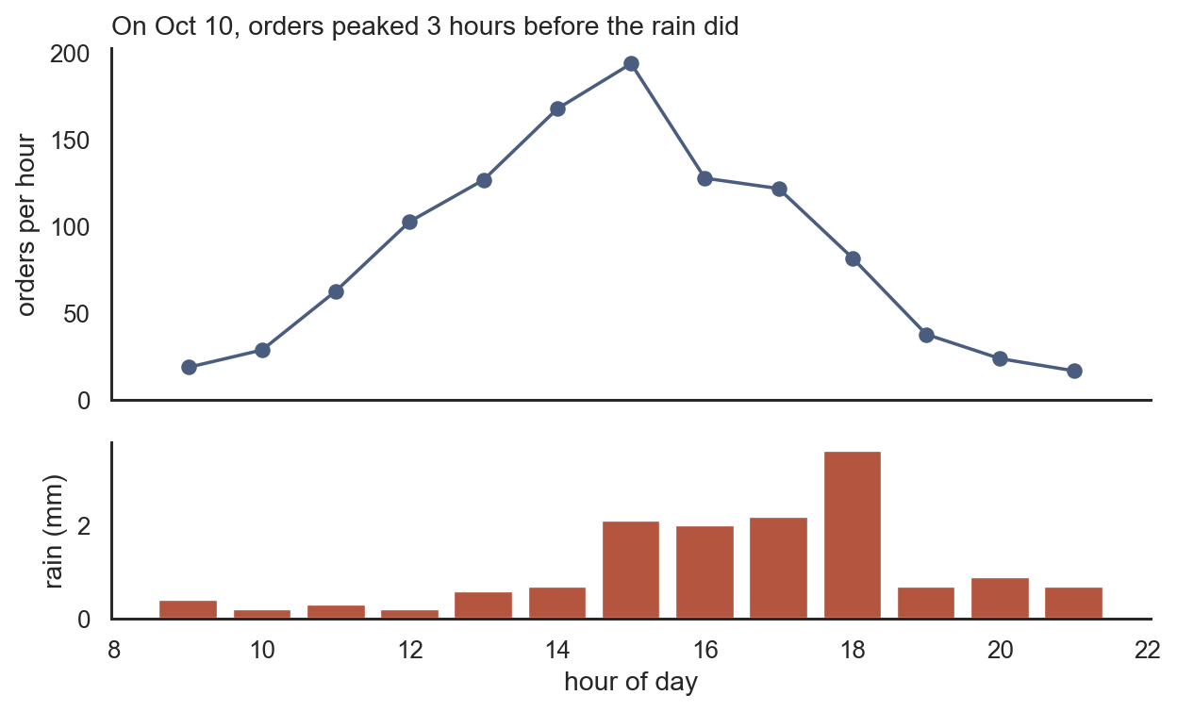
Recipe stacked panels
Two panels with sharex beats twinx. Different scales on one chart invite fake relationships.
21

Slide 22
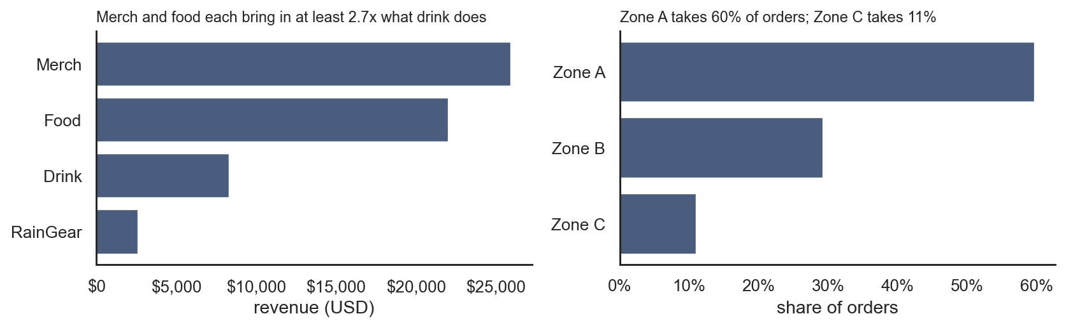
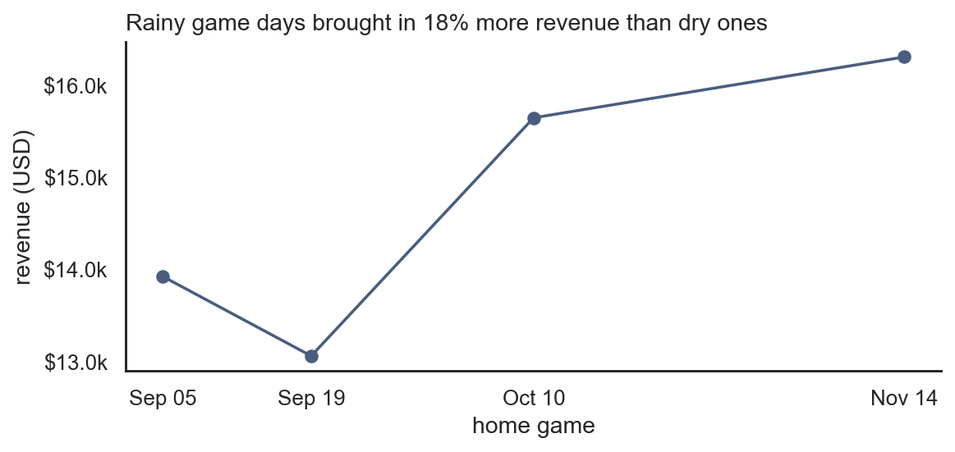
Recipe axis formatting
22

Slide 23
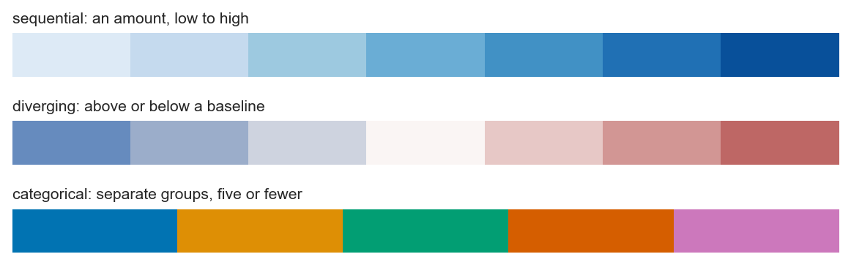
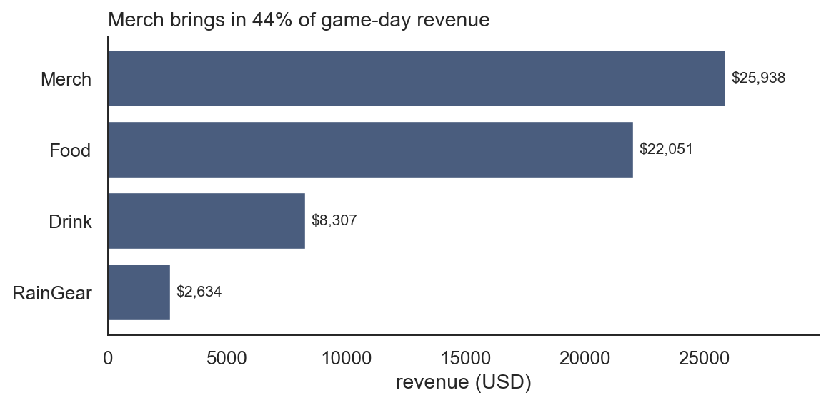
Recipe color and export
savefig before show. dpi=200, bbox_inches='tight', PNG for slides.
23

Slide 24
Four questions before the deck
01
What one sentence does this prove?
If you cannot say it, the chart is not ready.
02
Is that sentence the title?
Topic titles are for exploration, not presentation.
03
Are the units obvious?
USD, percent, orders per hour.
04
Is anything not carrying information?
Chartjunk, redundant legends, 3D.
Wednesday studio: run these against real charts, including some of yours.
24

Slide 25
Rewrite topic titles
Topic title | Message title
Revenue by category | Food and merch account for 73% of revenue
Orders by hour | Orders peak in the hour before kickoff
Revenue by zone | Zone A wins on total; Zone C wins per visitor
Compute the number in the title from the same data you plotted.
25

Slide 26
Cheat sheet
Question | Chart | Call
Which is biggest? | Sorted horizontal bar | ax.barh / sns.barplot
Change over time? | Line | sns.lineplot / ax.plot
Two groups? | Grouped bar | sns.barplot(hue=...)
Parts of total? | Stacked area | ax.stackplot
Move together? | Scatter | sns.regplot
Typical vs extreme? | Hist / box | sns.histplot / boxplot
Pattern in a grid? | Heatmap | sns.heatmap(pivot)
Too many lines? | Small multiples | sns.relplot(col=...)
Notebook on GitHub: 2026-11-09 Visualization for Decisions. Run setup once, then copy recipes.
26

